Slide 1

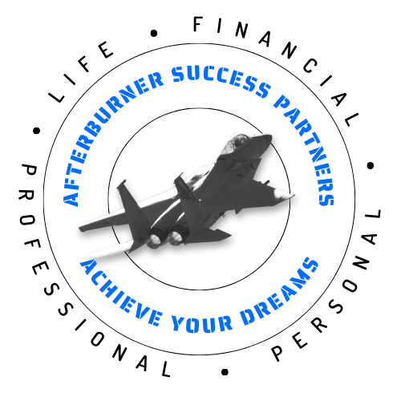

The Interview Process: A Three-Part Workshop
The Interview Process is a three-part workshop designed not only to get you the interview but also to help you get the job offer. It includes:
Part 1: Before your interview-Prepare for success
Part 2: During the interview-The successful interview
Part 3: After the interview-Finish strong
David Giustozzi
October 15, 2026
dave@absuccesspartners.com
Rev 0
Notes:
Introduction, overview of three-week workshop

Slide 2
The Interview Process:
After Your Interview
David Giustozzi
October 15, 2026
dave@absuccesspartners.com
Notes:
Today’s topic
I encourage you to take handwritten notes. Handwritten notes taken is proven to be the most effective way to learn material

Slide 3
The Interview Process-After Your Interview
Today’s Agenda:
Questions from last week, during the interview
What to do now that the interview is over
Questions and answers
Summary
Notes:
Review agenda.
Be sure to mention that questions along the way are encouraged

Slide 4
The Interview Process-After Your Interview
“Train Hard, Fight Easy”
-Alexander Suvoruv,
18th-century Russian General
Notes:
The purpose of this and the following slide is to emphasize the importance of doing the hard work, in this case the interview prep up front, so that when the interview occurs, there are no surprises and the candidate can perform at the highest level and be offered the job.
Alexander Ouvoruv was an 18th-century Russian general who believed that pushing limits during practice builds physical and mental strength.
He believed that facing tough conditions before combat makes the actual combat easier. His philosophy was obviously successful because General Suvorov never lost a battle
Today, his quote is often quoted for athletes.
The principle is the same, frankly, in any endeavor. The preparation makes the actual event easy.

Slide 5
The Interview Process-After Your Interview
"To each there comes in their lifetime a special moment when they are figuratively tapped on the shoulder and offered the chance to do a very special thing, unique to them and fitted to their talents. What a tragedy if that moment finds them unprepared or unqualified for that which could have been their finest hour.”
-Winston Churchill
Notes:
Winston Churchill was an inspirational statesman, orator, and leader who led Britain to victory during WWII
I admire Winston Churchill not only for his accomplishments during wartime, but also for his ability to communicate to the average person in ways that are plainspoken and relatable.
I have used this quote often in the past, and what it means to me is that we should always be prepared for an opportunity when it comes our way.
For us today, the point is that when we are in transition, we should always be ready for the eventual interview that will land us our next position. We never know when the opportunity may occur, so we must always be ready.
But interviewing skills are skills that last a lifetime. Indeed, the average person today will hold 12 different positions during their career. Being able to interview well will not only help you secure the next position, but it will also prepare you for promotional opportunities in the future.
Today, we want to talk about the steps you should take to be ready when your interview comes.

Slide 6
The Interview Process-After Your Interview
Last week we covered:
  Directly before the interview prep
  Potential interview questions
  Questions you should ask the interviewer(s)
  Closing comments
  Telephone interviews
  Virtual interviews
  Asynchronous interviews
  In-person interviews
Notes:
Briefly review last week’s workshop
See if there are any questions

Slide 7
The Interview Process-After Your Interview
You’ve had a great interview. Now, confirm why you are the best choice!
Immediately after the interview (all interview formats):
  Summarize the interview in paper or electronic form for your records
  What questions did they ask?
  How did you do?
  Where do you need to improve?
  What are the interviewer(s) names and contact information?
  Why is this important?
Notes:
These are the things you want to be sure you have accomplished directly before the interview?
You want to dress professionally for a telephone interview because it gets your mind framed for the interview and in the off chance that you may be asked to facetime the interviewers

Slide 8
The Interview Process-After Your Interview
Later that day or within 24 hours after the interview (all interview formats):
  Send thank-you notes. Paper, email or text format? Why?
  Send a summary letter. Emphasize your enthusiasm and excellent fit for the position
  If necessary, send a clarifying letter. Could be part of the summary letter
Why is the letter important? What format will you use?
Why is it important to do this quickly?
Notes:
These are the things you want to be sure you have accomplished directly before the interview?
You want to dress professionally for a telephone interview because it gets your mind framed for the interview and in the off chance that you may be asked to facetime the interviewers

Slide 9
The Interview Process-After Your Interview
In the days and weeks after the interview (all interview formats):
  Within 7 days, call or send a follow-up confirming your continued interest
  After 14 days, repeat
  After 30 days, repeat
  Is an in-person visit possible? What are your thoughts on this?
Why do companies delay in responding or making selections?
Why is it important to follow up?
It’s not over ’til it’s over- when is it truly over?
Notes:
These are the things you want to be sure you have accomplished directly before the interview?
You want to dress professionally for a telephone interview because it gets your mind framed for the interview and in the off chance that you may be asked to facetime the interviewers

Slide 10
The Interview Process-After Your Interview
There are a few “never-evers”:
Never-ever ghost an employer. No matter what stage of the interview. Because…
Whether or not you were a viable candidate for the current opening, someday there will be others. At the same company. That you might be a fit for. Tomorrow or the next day. Because…
It is said there are only 6 degrees of separation between everyone in the world. I always say that in Tulsa, that is two degrees. Everyone knows everyone. And they all talk. Maybe about you. So…
Never burn bridges. Like eating a jalapeño, what you do or say today can burn tomorrow…
Notes:
These are the things you want to be sure you have accomplished directly before the interview?
You want to dress professionally for a telephone interview because it gets your mind framed for the interview and in the off chance that you may be asked to facetime the interviewers

Slide 11
Resources
The following books/resources may be helpful to you:
  The OJT website
  What Color is Your Parachute by Richard Nelson Bolles
  Knock ‘em Dead Job Interview by Martin Yale
  Interview Tips and Notes-Coltec Consulting (Glen Hall)
Notes:
These are additional materials that I’ve used that may be helpful

Slide 12
Questions?
Notes:
We ask for questions before the summary as we don’t want to finish the presentation “hanging.” We take questions now then summarize to finish strong.

Slide 13
The Interview Process-After Your Interview
Summary:
  The interview is not over until a decision has been made AND the selectee reports to work
  Even if you were not selected for this position, a good interview process can make you a candidate for a future position
  Your job after the interview it to take the steps necessary to keep yourself in the front of the interviewer(s) mind. To stand out so you can be selected for the position
  The sweet spot is to stay fresh in their mind but not be a pest. NEVER appear desperate
  It’s not over until it’s over
Notes:
Review each bullet point. No questions after this slide

Slide 14
The Interview Process-During Your Interview
Was this workshop helpful?
Please provide feedback!
Notes:
Announce next week’s agenda.
There likely will be some questions that arise; take those in person after the workshop is concluded

